Slide 1
Exploratory Teacher and Student Screens
Skills Library Database
Fall 2024
For technical assistance:
Jennifer Leonard | jleonard@skillslibrary.com| Phone/Text: 781-321-7894

Slide 2
QUICK REFERENCE
Find today’s schedule for any student:
https://skillslibrary-rsta.com/scheduletoday.asp?key=key1
Calendar https://skillslibrary-rsta.com/expcalendar.asp
SIGN IN TO THE SKILLS LIBRARY DATABASE: https://skillslibrary-rsta.com
STUDENT SCREENS: Use individualized link or sign in with name & student ID at https://skillslibrary-rsta.com/studentpages or via the shortcut link rsta.me

Slide 3
Exploratory Student Screens
Skills Library Database
Fall 2024

Slide 4
Before the first exploratory week begins, students receive an email telling them that the exploratory program is beginning, with a brief overview plus:
the name of their first class;
a personalized link to the student screens
If students don’t have their personalized link they can go to the shortcut rsta.me (or the full link https://skillslibrary-rsta.com/studentpages and sign in with their student ID and first name and email address.
Teachers and staff can look at a sample screen by signing in with the student ID =1234 and the name = Sample.

Slide 5
Students will receive an email each day with their rotation schedule for the day; throughout both phases of the Exploratory program., and with the link to sign in to see their schedule and complete their online reflection journal entries.
The email will come from exploratory@skillslibrary-rsta.com
Students can find all of the information they need and complete their journal assignments in the student screens.

Slide 6
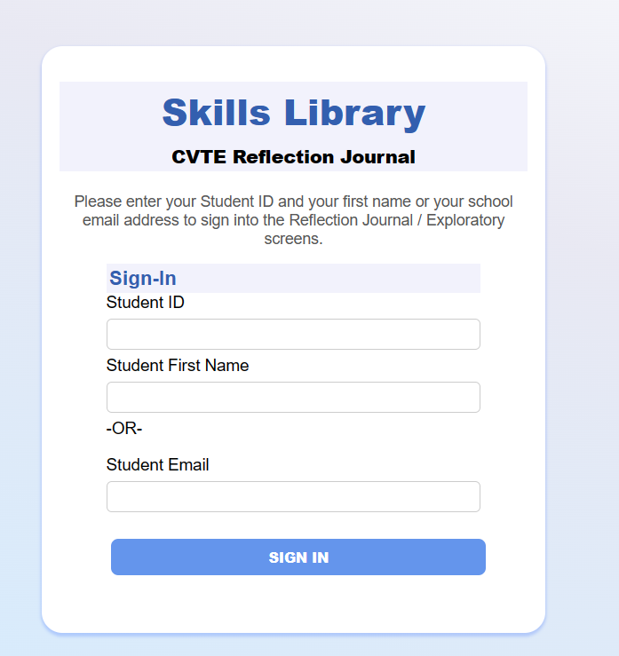
The individualized link bring students to a home page (see next slide) or the link brings students to this sign-in screen
Students initially sign in with their name and email or ID, and later set their own password.

Slide 7
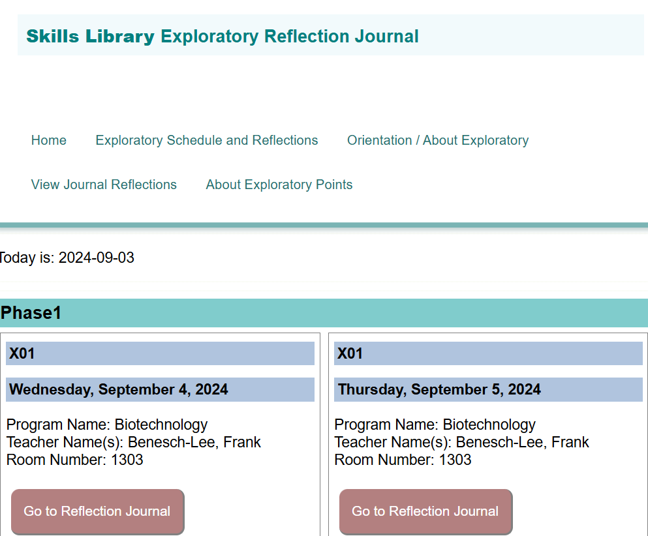
The student screens includes the student’s personalized schedule. For each day of the program, they see the date, time, program name, teacher name(s) and the room number and floor.
From the signin page and dashboard, students click EXPLORATORY to see their schedules.

Slide 8
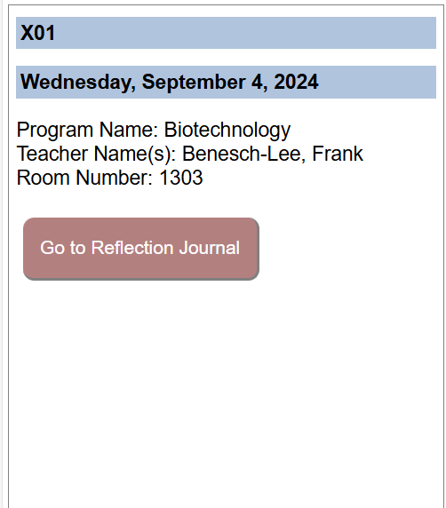
Students will write a brief reflection journal entry for each session.
Students earn exploratory points for completing these entries.
Once an entry is completed, a checkmark will appear in the box.

Slide 9
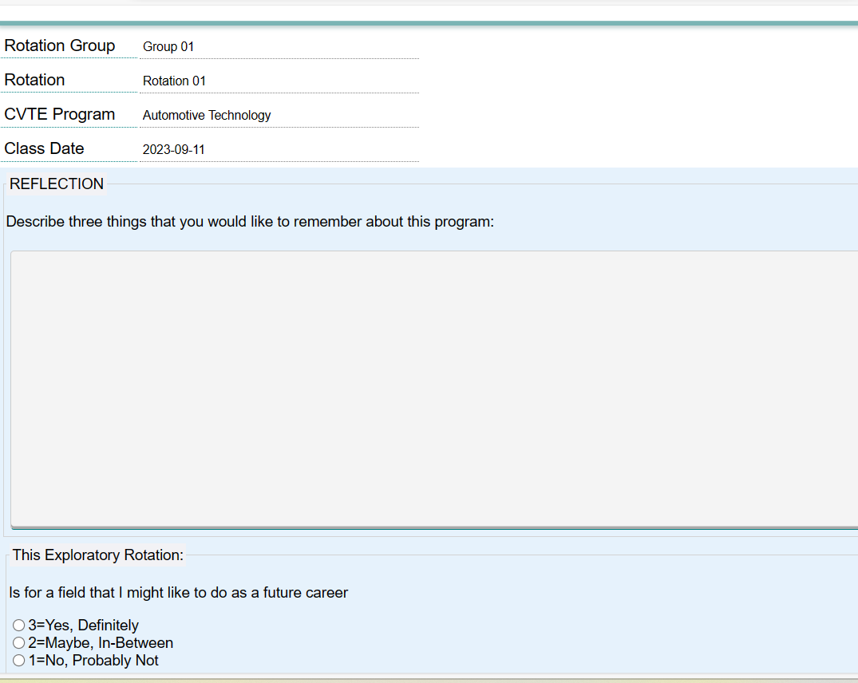
This is the reflection screen. Students write and SAVE their reflections for each session.

Slide 10
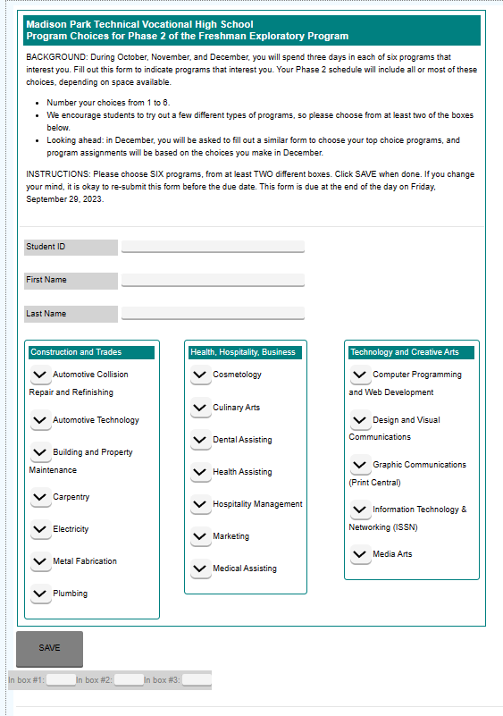
Later in the Exploratory program, students will use the Exploratory screens to fill in program choice forms, career interests exercises, surveys or other items.

Slide 11
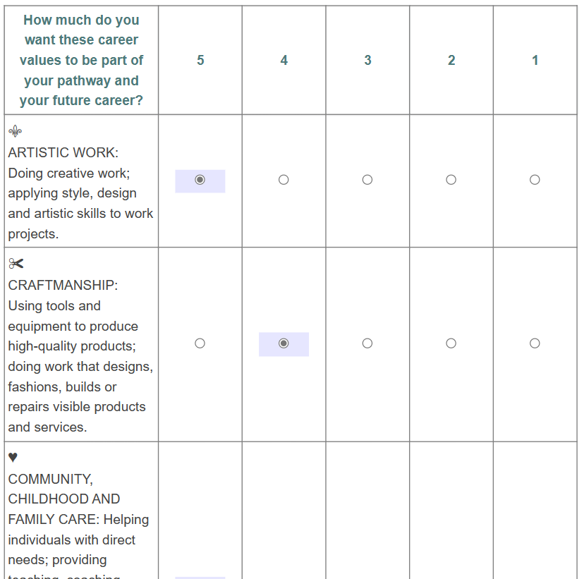
Later in the Exploratory program, students will use the Exploratory screens to fill in program choice forms, career interests exercises, surveys or other items.

Slide 12
Exploratory Teacher Screens
Skills Library Database
Fall 2024

Slide 13
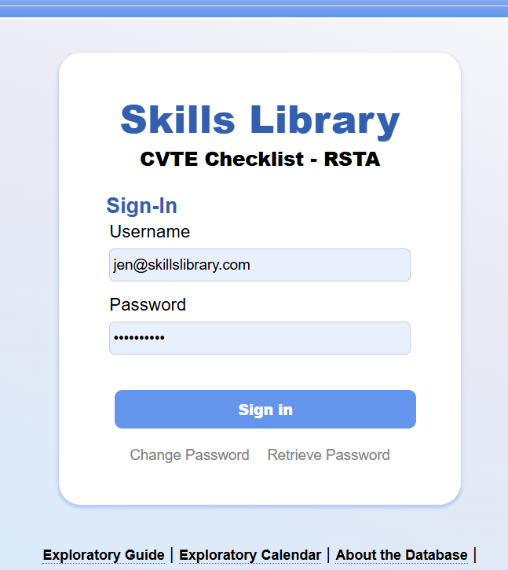
Sign into the Skills Library database at https://skillslibrary-rsta.com
(or go to skillslibrary.com and look in the corner for a link).
Email Jennifer Leonard at jleonard@skillslibrary.com for a username and password.

Slide 14
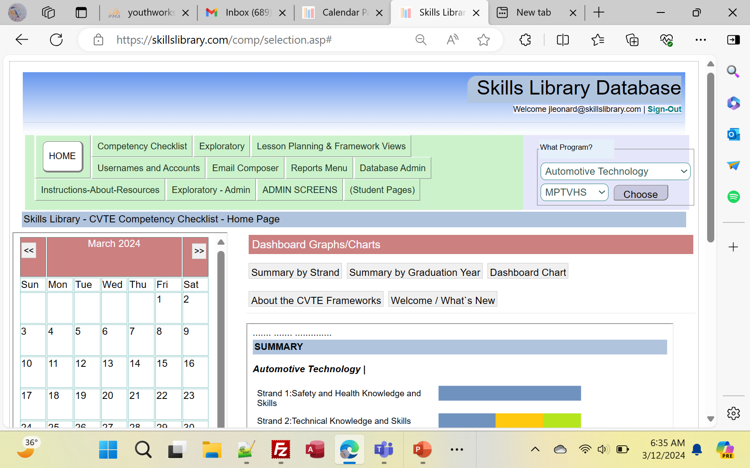
The exploratory calendar and other features appear on the home page.
All of the Exploratory screens are found under the tab “Exploratory” on the navigation bar along the top.

Slide 15
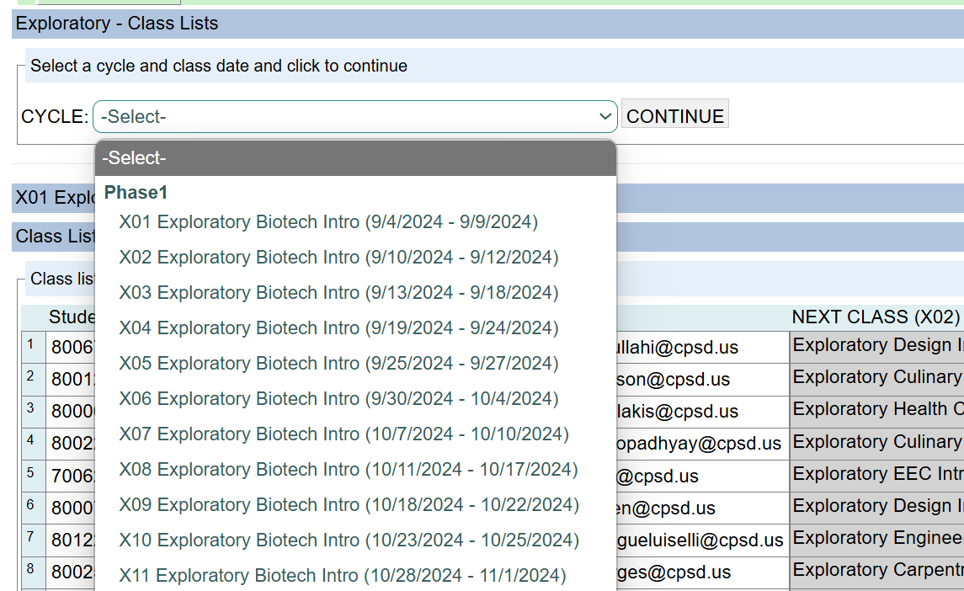
Under the “Exploratory” tab, choose the option to view print Class Lists” to view and print class lists.
Choose a rotation and click to continue.

Slide 16
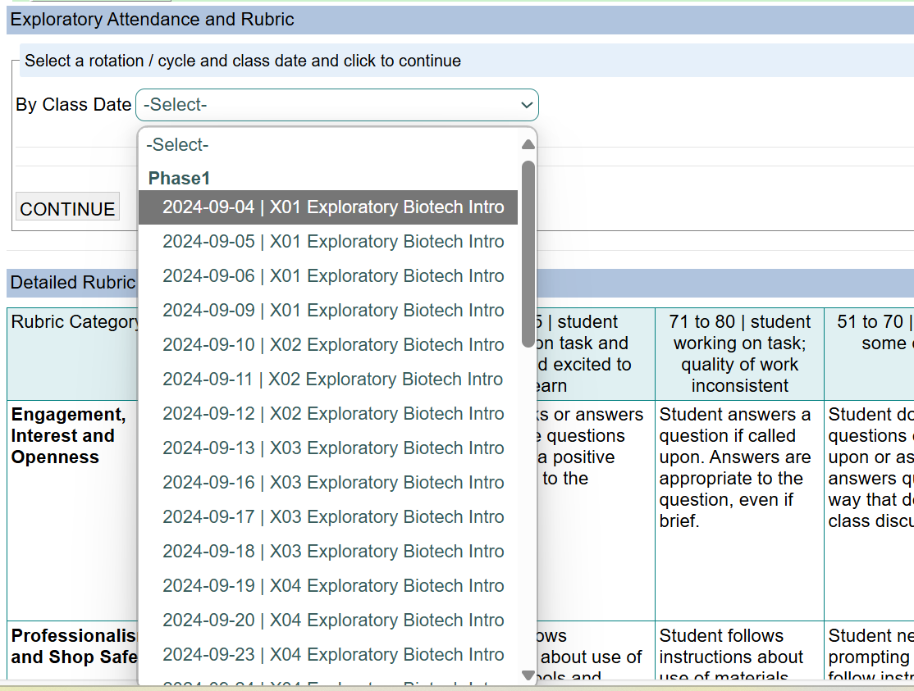
(1) Under the “Exploratory” tab, click on the link for the Attendance and Rubric screen to open the screen that you will use to track attendance and scores.
(2) When that screen opens, choose a class date and rotation and click CONTINUE.
Today’s date will be highlighted in yellow. Dates that you have data entered for will have a checkmark next to the date.

Slide 17
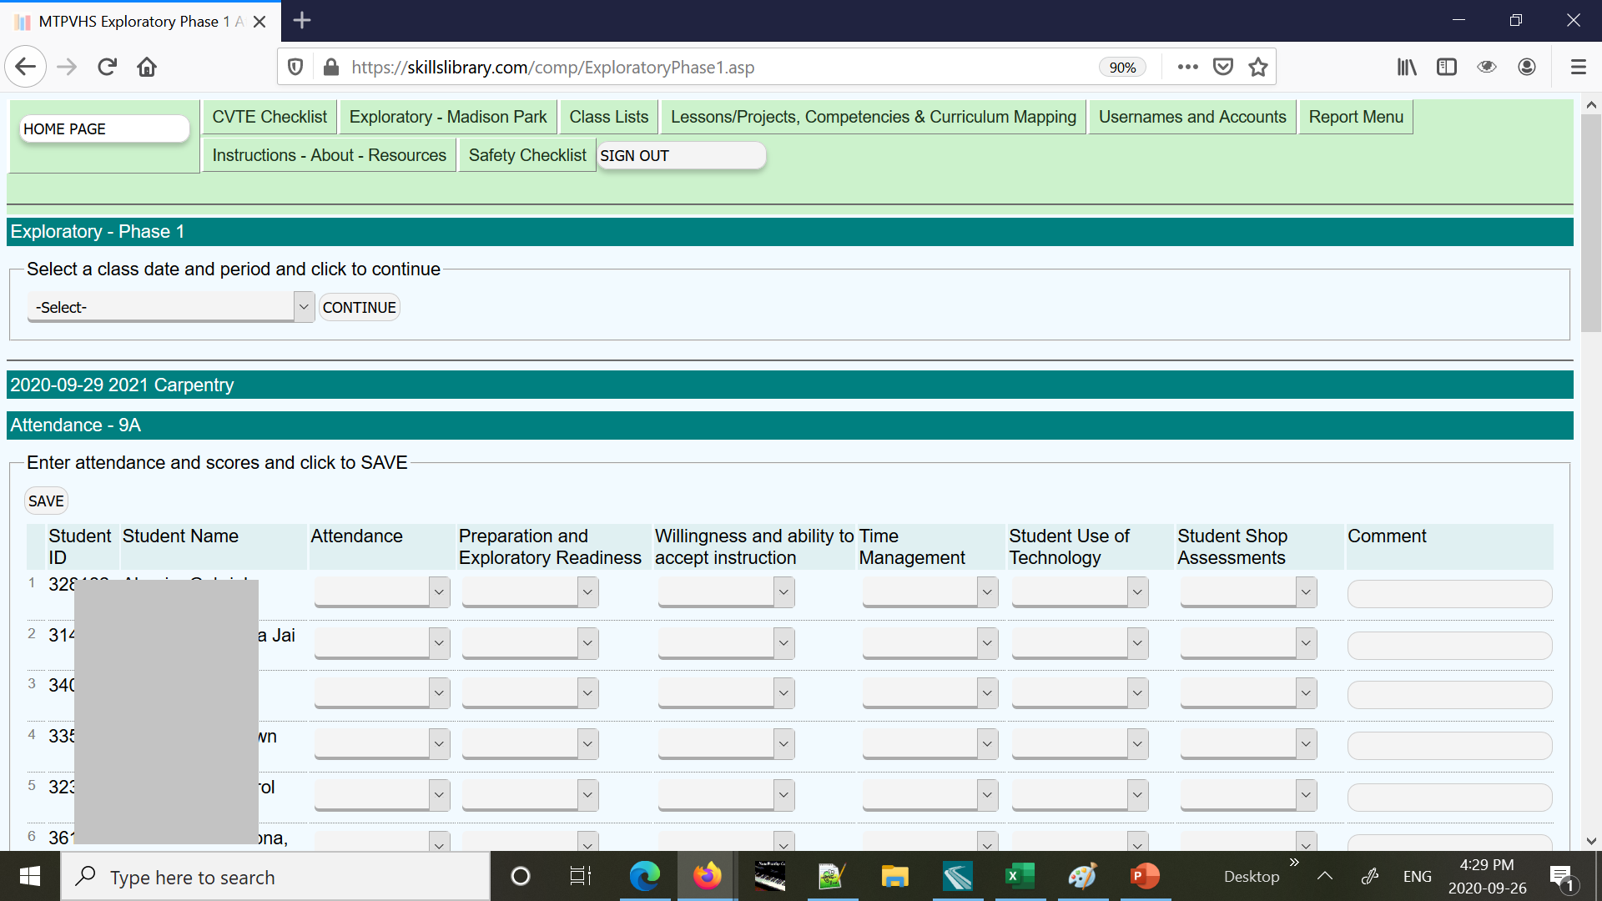
This is the screen for entering attendance and scores. Student names appear along the right, and there are columns for the Attendance and for the scores in the different rubric categories.

Slide 18
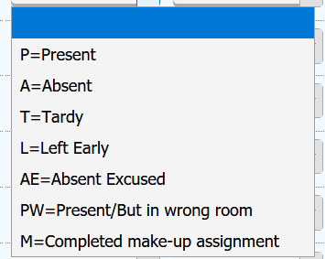
The attendance column has a dropdown with codes including P for Present, A for Absent, M for Make-up class, and other options.
The rubric columns are text boxes and must have a score 50-100, based on the rubric shown at the bottom of the page.
Use a 0 (zero) if the student was absent or if an item is not applicable or unknown. Zeroes will not count in the final exploratory scores.

Slide 19
Look under the “Exploratory” tab for summaries of the Reflection Journal entries, Attendance, and other data.
For Administrators – Look under the “Exploratory – Admin” tab for screens for creating the calendar, managing class lists, and other tasks.

